Slide 1

Building applications with Xamarin
Sorin Peste, Microsoft
Sorin.Peste@microsoft.com

Slide 2

MSFTOPEN

Slide 3

Journey to Windows 10
Windows Desktop
Windows Phone
ONE CORE OS
ONE APP PLATFORM
ONE STORE
Windows 10
Xbox
IoT
HoloLens
Surface Hub
Notes:
It has been a real journey for us to get to One Windows with Windows 10. Back in Windows 7 we started our journey to bring together Windows into one, scalable platform which could support the growing variety of devices and scenarios that developers wanted to build app experiences for. We started by merging the lower level parts of the OS, then the developer experience, and now with Windows 10, we have unified all of the Windows family.
At the same time, we have been able to quickly add several new device families to Windows. This has been a multiyear journey and with Windows 10 we now have One core operating system, One app platform, and One store to empower developers to reach their Windows customers wherever they are and on whatever device they happen to be using.

Slide 4
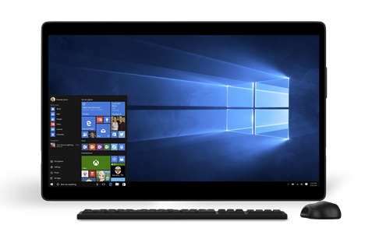
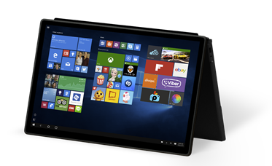
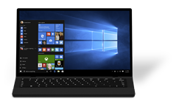
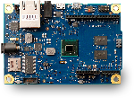

Bringing our device family together
29 July 2015
1.25 billion Windows Store visits
2x engagement on the Windows Store*
110 million Windows 10 devices
4x dev revenue per Windows 10 device*
* Compared to Windows 8.1
Notes:
On July 29, 2015 Windows 10 was made generally available for desktops, laptops and tablets, as well as IoT devices, such as the Raspberry Pi 2. In the few months since Windows 10 launched, we’ve seen great adoption and engagement of Windows 10 and the Windows Store. Since launch, we’ve seen over 1.25 billion Windows Store visits from over 110 million devices. Engagement on the Windows Store is up 2x compared to Windows 8.1, which resulted in 4x revenue for developers.

Slide 5
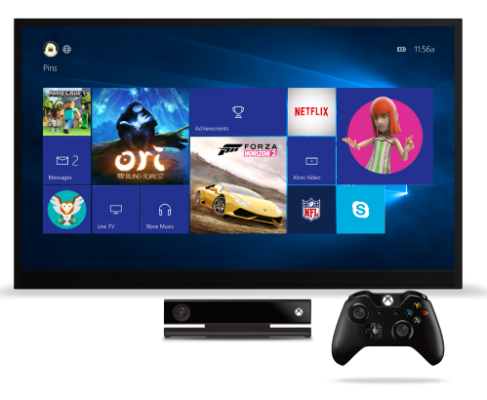
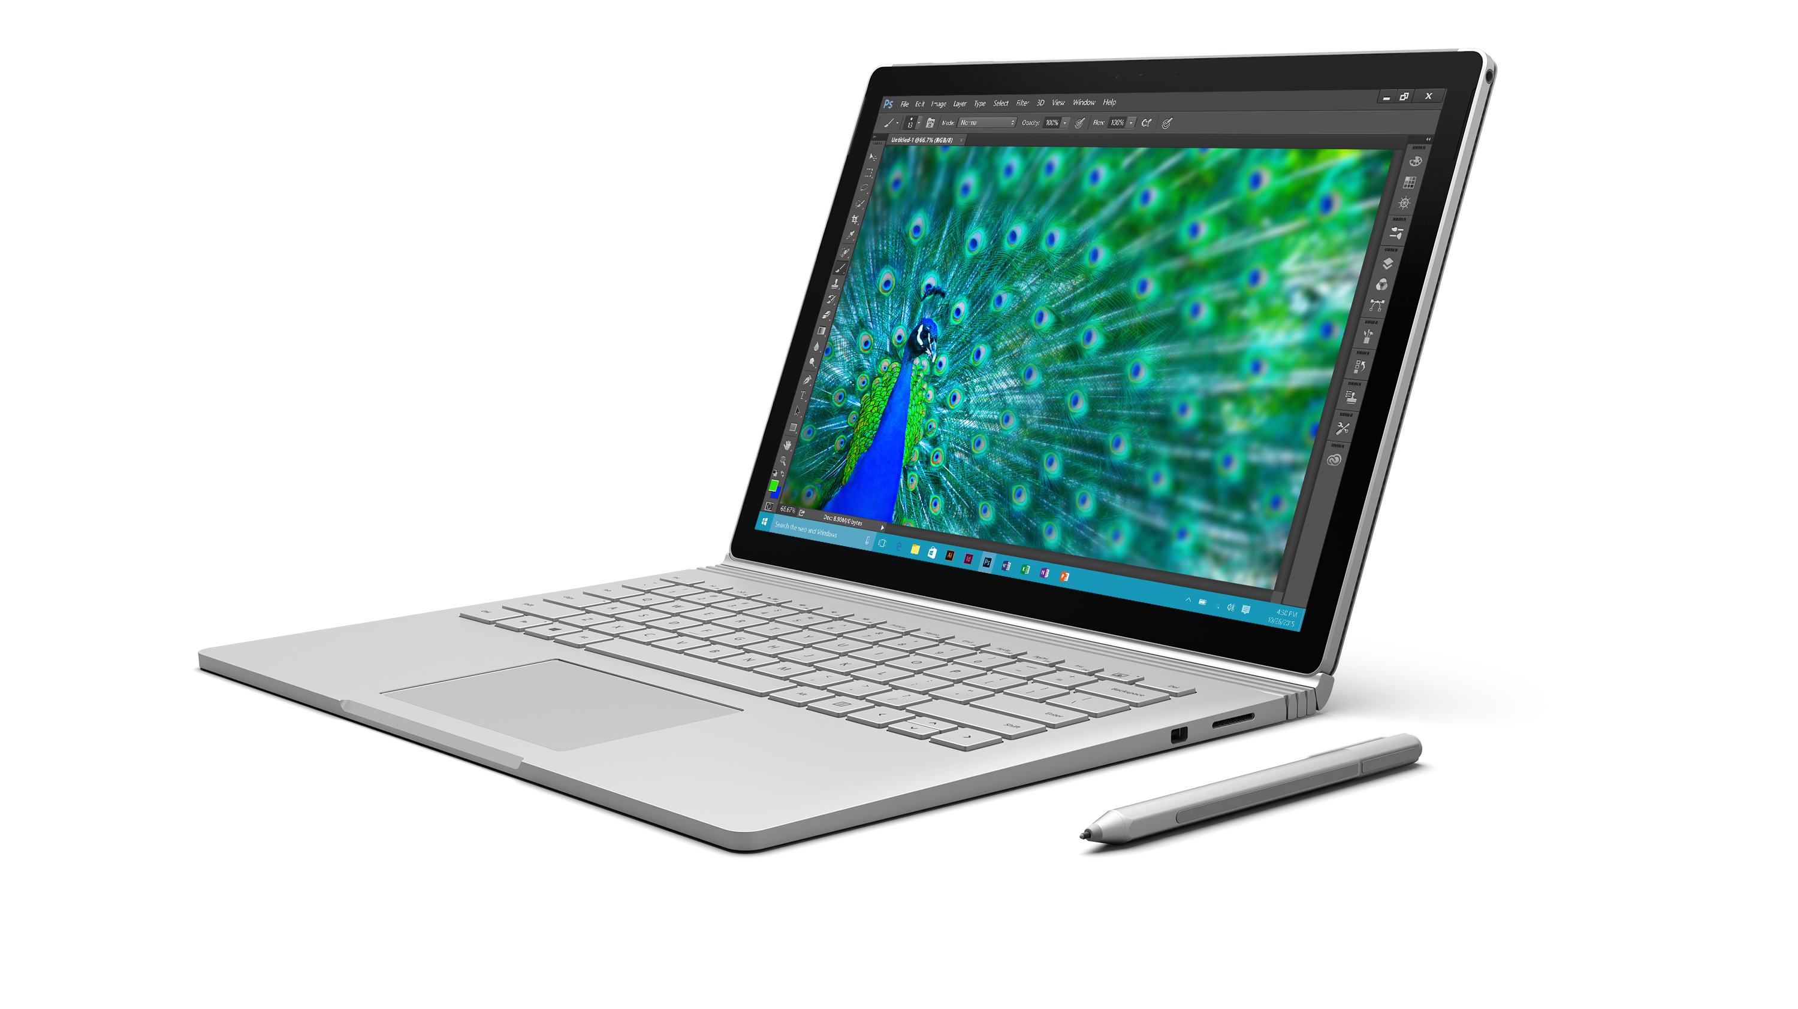
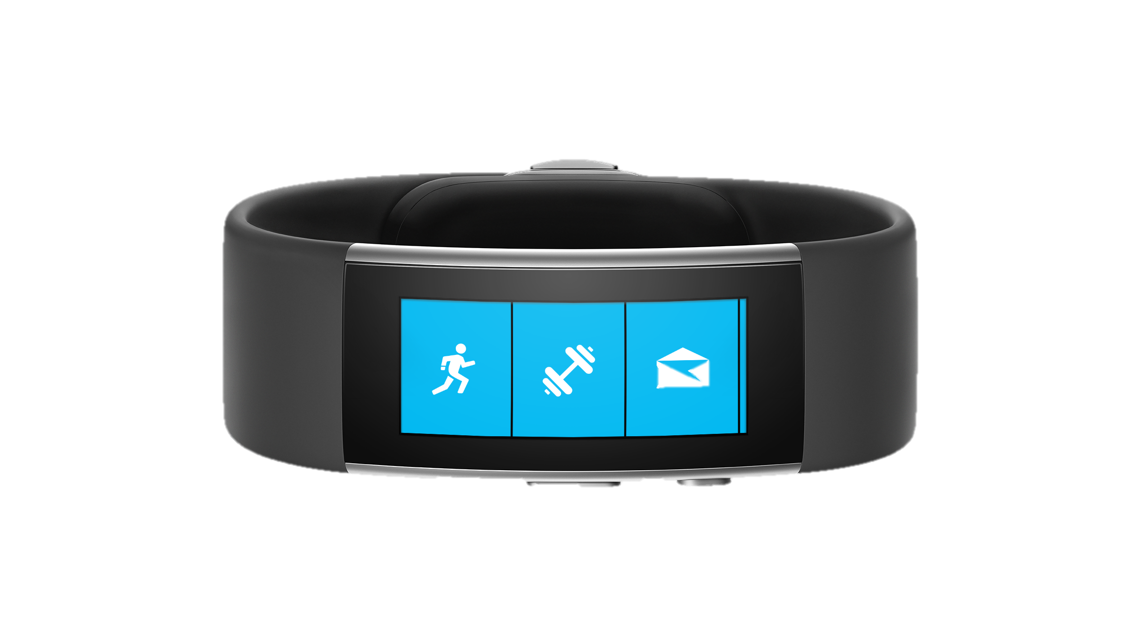
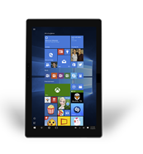
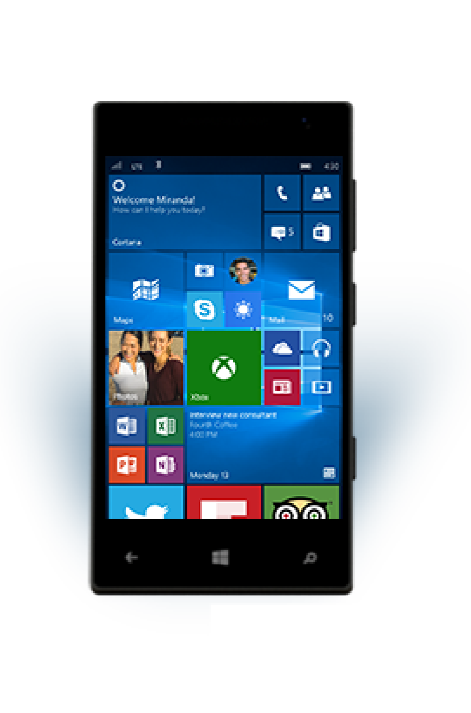
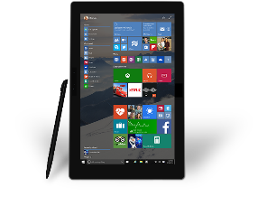
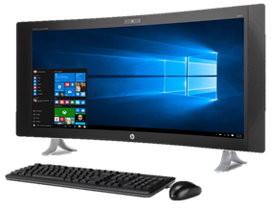
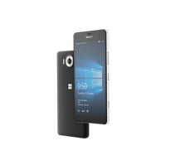
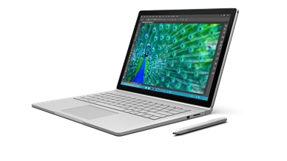
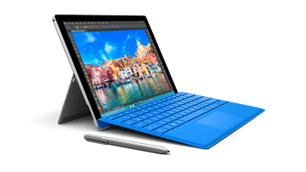
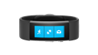



Bringing our device family together
29 July 2015
Holiday 2015
Notes:
In the holiday 2015 timeframe, we’re bringing Windows 10 to phones with Windows 10 Mobile, as well as Xbox One with the New Xbox One Experience. There’s also a great lineup of new hardware available, ranging from our own Microsoft Band 2, new Lumia 950 and 950 XL phones, to Surface Pro 4 and Surface Book, alongside great hardware from our OEM partners.

Slide 6
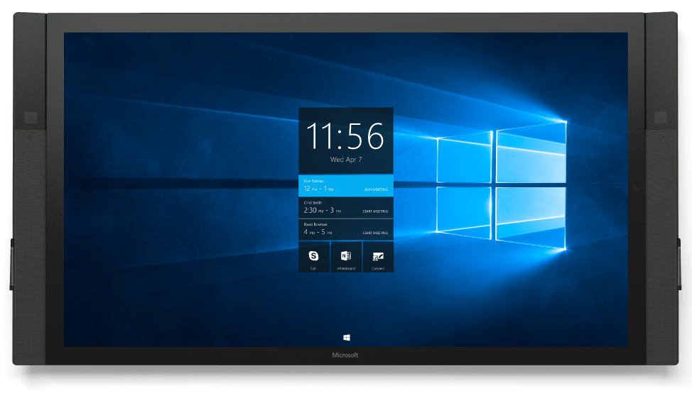
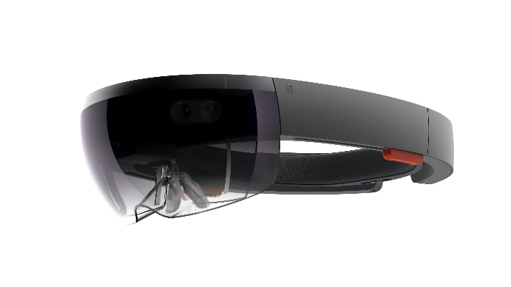
Bringing our device family together
29 July 2015
Holiday 2015
Early 2016
Notes:
And we’ll continue to bring our device family together early 2016 with new experiences across Microsoft HoloLens and Surface Hub.

Slide 7

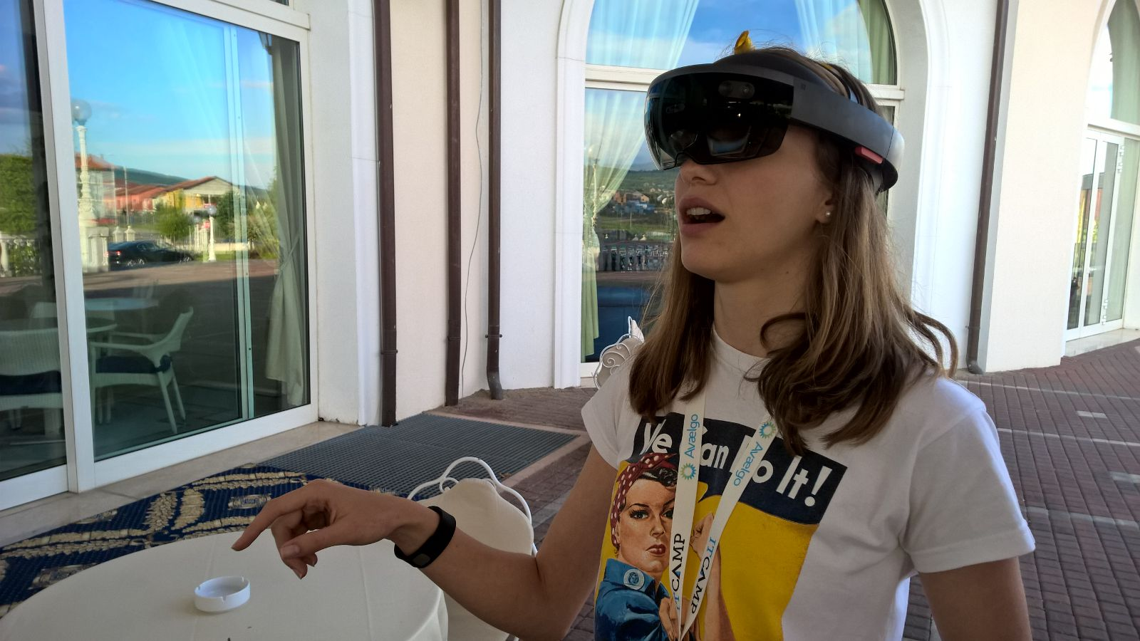
HoloLens

Slide 8
Universal Windows Platform
Universal Windows Platform
Devices +IoT
Holographic
PC
Mobile
Xbox
Surface Hub
Adaptive User Interface
Natural User Inputs
One SDK + Tooling
One Store + One Dev Center
Cloud Services
Configuration
Security
Management
Updates
Notes:
Whether a developer wants to provide end users with a consistent experience that seamlessly adapts or if they decide to tailor the experience to take advantage of specialized capabilities of a specific device, they have one set of APIs, tools, and services enabling them to leverage the same code and visual assets.
Of course, the Universal Windows Platform provides a number of services to enable developers to easily build apps including:
Adaptive User Interface control library – allowing developers to design a User interface that adapts and reacts to the device family it’s running on
Natural user inputs: Speech, ink, gesture vision, and a host of new input models that work with the new UI control library.
One SDK and Tooling to simplify the development process
One Store: with universally available apps and games, digital media and a single dev center
Cloud Services with Microsoft Azure to create compelling connected experiences
Last but not least, the Universal Windows Platform also means a unified way of configuring, securing, managing and updating devices across the various form factors.

Slide 9
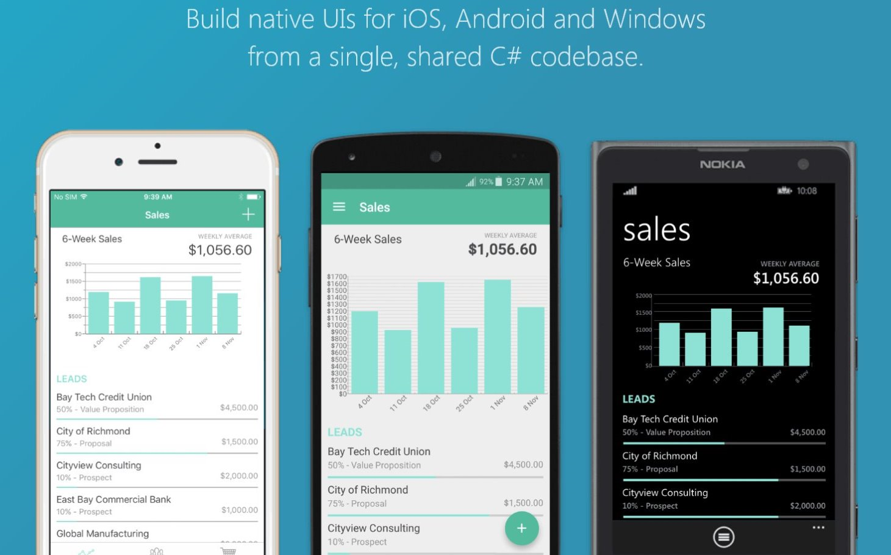
Build native UIs for iOS, Android and Windows from a single, shared C# codebase.

Slide 10

Silo’ed approach
Objective-C, Swift
XCode
Building native apps multiple times means
Client development is completely different for each device type
Only the Services (server-side) can be reused, with certain differences when consuming them
TCO grows exponentially
Java
Eclipse
C#, JS, C++
Visual Studio

Slide 11
Write-once-run-anywhere approach
CSS • HTML • TypeScript • JavaScript • Ionic • …
Write-once-run-anywhere
box
Hybrid apps. Presentation written in HTML/CSS and behavior written in JavaScript/TypeScript
Highest code reuse ratio at UI expense
Performance depends on the container
Apache Cordova/Ionic

Slide 12
Xamarin approach
iOS
iOS C# UI
Android C# UI
Windows C# UI
Fully native apps written entirely in C#
Build apps with beautiful UX and native performance for Android, iOS & Windows
Be productive with templates, Intellisense, debugger, designer integration, emulators, deployment
Code share with PCLs
Create specific UI or share UI with Xamarin.Forms
Use C# APIs with 100% of platform APIs exposed
Connect to Azure for backend enterprise systems
Xamarin.Forms
Shared App Logic
Platform Specific Framework

Slide 13
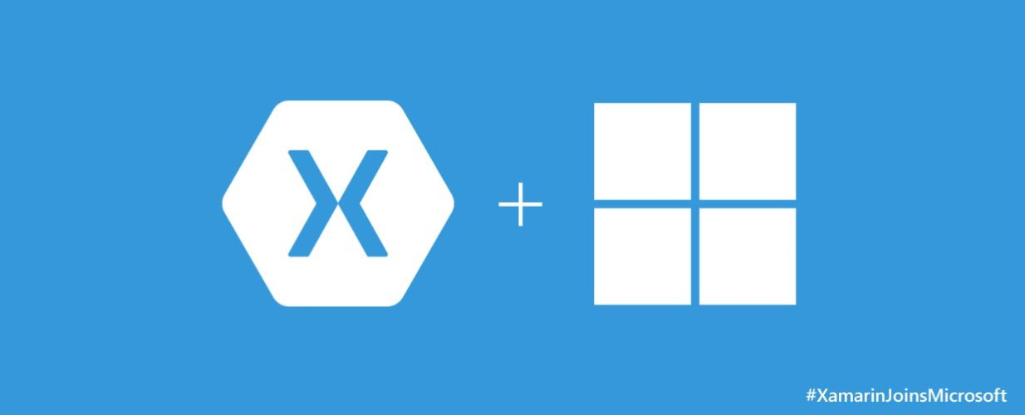

Slide 14
https://developer.xamarin.com/

